Slide 1
QUALITY – INSPECTION RECORDS (WIR / MIR )
INSPECTIONS DATA | MATERIAL INSPECTION REQUEST (MIR) |  |  |  |  |  | WORK INSPECTION REQUEST (WIR)/CHECKLIST
 | UP TO LAST MONTH (CUM. DATA FROM START ) Till 31st Aug 2025 |  |  | THIS MONTH From 1st Sept to 30th Sept 2025 |  |  | UP TO LAST MONTH (CUM. DATA FROM START ) Till 31st Aug 2025 |  |  | THIS MONTH From 1st Sept to 30th Sept 2025
 | RECEIVED | CLOSED | REJECTED | ISSUED | CLOSED | REVISED/ RESUBMIT REJECTED | ISSUED | CLOSED | REVISED/ RESUBMIT | ISSUED | CLOSED | REVISED/ RESUBMIT
RCC | 88 | 88 | 0 | 9 | 9 | 0 | 202 | 202 | 0 | 37 | 37 | 0
Finishing
MEP
Façade- Windows/Railing
Other
Total | 88 | 88 | 0 | 9 | 9 | 0 | 202 | 202 | 0 | 37 | 37 | 0

Slide 2
QUALITY – OBSERVATIONS RECORDS (OBR)
SR. NO. | DESCRIPTION | (A) UP TO LAST MONTH (CUM. DATA FROM START ) Till 31st Aug 2025 |  |  | (B) THIS MONTH From 1st Sept to 30th Sept 2025 |  |  | TOTAL ( A + B ) |  |  | CLOSURE DATE/ ACTION PLAN
 |  | ISSUED | CLOSED | OPEN | ISSUED | CLOSED | OPEN | ISSUED | CLOSED | OPEN
1 | RCC | 92 | 85 | 7 | 15 | 15 | 0 | 107 | 100 | 7 | Mention action plan with target date.
2 | Structural Steel
3 | Block Work
4 | Plastering Works
5 | Waterproofing
6 | Gypsum Works
7 | Doors
8 | Flooring works
9 | Painting works
10 | False Ceiling
11 | Fins Work
12 | Railing works
13 | Trimix
14 | MEP
15 | Others
Total |  | 92 | 85 | 7 | 15 | 15 |  | 107 | 100 | 7

Slide 3
QUALITY – NC RECORDS
SR. NO. | DESCRIPTION | (A) UP TO LAST MONTH (CUM. DATA FROM START ) Till 31st Aug 2025 |  |  | (B) THIS MONTH From 1st Sept to 30th Sept 2025 |  |  | TOTAL ( A + B ) |  |  | CLOSURE DATE/ ACTION PLAN
 |  | ISSUED | CLOSED | OPEN | ISSUED | CLOSED | OPEN | ISSUED | CLOSED | OPEN
1 | RCC | 3 | 3 | 0 | 2 | 2 | 0 | 5 | 5 | 0 | Mention action plan with target date.
2 | Structural Steel
3 | Block Work
4 | Plastering Works
5 | Waterproofing
6 | Gypsum Works
7 | Doors
8 | Flooring works
9 | Painting works
10 | False Ceiling
11 | Fins Work
12 | Railing works
13 | Trimix
14 | MEP
15 | Others
Total |  | 3 | 3 | 0 | 0 | 0 | 0 | 5 | 5 | 0

Slide 4
Material Rejections
Sr. No | Material Name | Unit | Quantity |  |  | Disposal of Rejection issue
 |  |  | 1st Sept 25 to 30th sept 25 | Q4FY25 (1st Aug 25 to 30th Nov 25) | FY25 (1st Apr 25 to 31st Mar 26)
1 | Concrete- Shree Venkatesh RMC – M45FF | Cu.m. | 0 | 0 | 43.5 | Flow drop noticed
2 | Concrete- Shree Venkatesh RMC – M35 | Cu.m. | 0 | 0 | 8 | Slump drop noticed
3 | Concrete- VP infra RMC – M40FF | Cu.m. | 0 | 0 | 40 | Flow drop noticed
4 | Concrete- VP infra RMC – M50 | Cu.m. | 0 | 0 | 3.5 | Segregation and bleeding.
5 | Concrete- Shree Venkatesh RMC – M30 | Cu.m | 0 | 0 | 30 | Slump drop noticed
6 | Concrete- BRV RMC – M30 FF | Cu.m | 0 | 5 | 5 | Flow drop noticed

Slide 5
Material Testing Details For Sept 2025
Sr. No | Material | Brand name | Product name | Test Conducted | Site / Field test | No. of Site lab Test | No. of Third Party Test | Test Result
1 | Cement | Orient/Dalmia/ Vasavadatta/ Ultratech/Bharati | Cement | Physical & Chemical | Fineness Test/ Consistency/Compressive Strength | - | Once in 6 months | Passed
2 | Fly ash | Parali | PFA | Physical & Chemical | Fineness Test | - | Once in 6 months | Passed
3 | GGBS | - | - | Physical & Chemical | - | - | - | -
4 | Microsilica | - | MS | Physical & Chemical | - | - | - | -
5 | P500 | - | P500 | Physical & Chemical | - | - | - | -
6 | Fine aggregate | Talegaon | Crusher Sand | Physical & Chemical | Sieve analysis, Silt content, Specific Gravity & Water Absorption, DLBD, Aggregate Impact Value, Aggregate Crushing Value | - | Once in 6 months | Passed
7 | Coarse aggregate | Talegaon | 10mm & 20mm | Physical & Chemical | Sieve analysis, Silt content, Specific Gravity & Water Absorption, Flakiness & Elongation Index, DLBD, Aggregate Impact Value, Aggregate Crushing Value | - | Once in 6 months | Passed
9 | Fine aggregate | - | River Sand | Physical & Chemical | - | - | - | -
10 | Water | Borewell | Water | Physical & Chemical | pH test, Organic & Inorganic Solids, Chloride ion content & Sulphate content | - | Once in 3 months | Passed
11 | Admixture | Asian paints/ Chryso/Sika/CCPL | MPC, HPC | Physical & Chemical | Specific gravity, pH, Dry Materials Content, Ash Content & Chloride Ion Content | - | Once in 6 months | Passed

Slide 6
R/F Steel & Concrete Testing Details Sept 2025
Reinforcement steel Testing Summary
SR.NO. | MAKE | CHALLAN WEIGHT IN MT |  |  |  |  |  |  |  | No. of Test results |  |  |  | REMARK
 |  | 8mm | 10mm | 12mm | 16mm | 20mm | 25mm | 32mm | 40mm | Bend Test on site | Rolling margin | Physical test | Chemical Test
1 | SANGAM | 71 | 11.83 | 36.69 | 12.50 |  |  |  |  | Ok | Ok | Ok | OK
2 | Roopam |  |  |  |  |  | 29.55 | 16.99 |  | OK | Ok | OK | Ok
3 |  |  |  |  |  |  |  |  |  | ok | ok | ok | ok
Total steel dia wise MT |  | 71 | 11.83 | 36.69 | 12.50 |  | 29.55 | 16.99
Total steel MT |  | 141.87

Slide 7
Concrete summary for Sept 25
Tower no. 7 | Sum of Total Qty. Supplied (Cum.) | Average of 7 Days Compressive Strength (N/mm2) | Average of 28 Days Compressive Strength (N/mm2) | % Strength Achieved
M10
M15
M20
M30
M30FF | 989 | 21.54 | 39.22
M35
M35FF
M40
M40FF
M45FF
M50
M50FF
Add Concrete grade of Tremix
Any other grade not covered above
Grand Total | 989 | Cum

Slide 8
Concrete summary for Sept 25
Tower no. 8 | Sum of Total Qty. Supplied (Cum.) | Average of 7 Days Compressive Strength (N/mm2) | Average of 28 Days Compressive Strength (N/mm2) | % Strength Achieved
M10
M15
M20
M30
M30FF | 588.50 | 21.66 | Awaited
M35
M35FF | 361 | 27.70 | 44.52
M40
M40FF
M45FF | 10 |  | Awaited
M50
M50FF
Add Concrete grade of Tremix
Any other grade not covered above
Grand Total | 949.50 | Cum

Slide 9
Concrete summary for Sept 25
Tower no. 9 | Sum of Total Qty. Supplied (Cum.) | Average of 7 Days Compressive Strength (N/mm2) | Average of 28 Days Compressive Strength (N/mm2) | % Strength Achieved
M10
M15
M20
M30
M30FF
M35
M35FF
M40
M40FF
M45FF
M50
M50FF | 558 | 41.82 | 58.86
Add Concrete grade of Tremix
Any other grade not covered above
Grand Total | 558 | Cum.

Slide 10
Concrete summary for Sept 25
Podium | Sum of Total Qty. Supplied (Cum.) | Average of 7 Days Compressive Strength (N/mm2) | Average of 28 Days Compressive Strength (N/mm2) | % Strength Achieved
M10
M15
M20
M30 | 1012.50 | 27.20 | 43.39
M30FF
M35 | 7 | 28.65 | 46.20
M35FF
M40
M40FF
M45FF
M50 | 101 | 39.15 | 58.60
M50FF
Add Concrete grade of Tremix
Any other grade not covered above
Grand Total | 1120.50 | Cum.

Slide 11
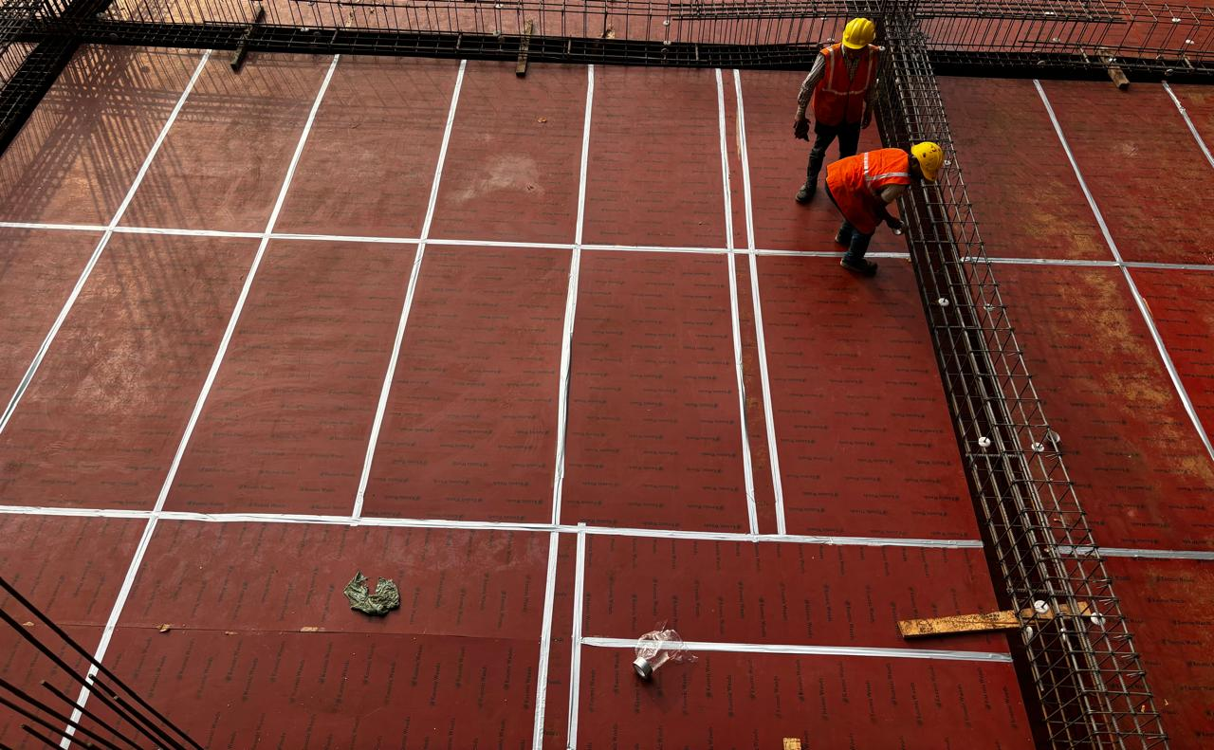
BEST PRACTICES
Description:
Use of Silver tape in ply joints to avoid slurry leakages & minor offsets in slab soffit.(Podium)

Slide 12
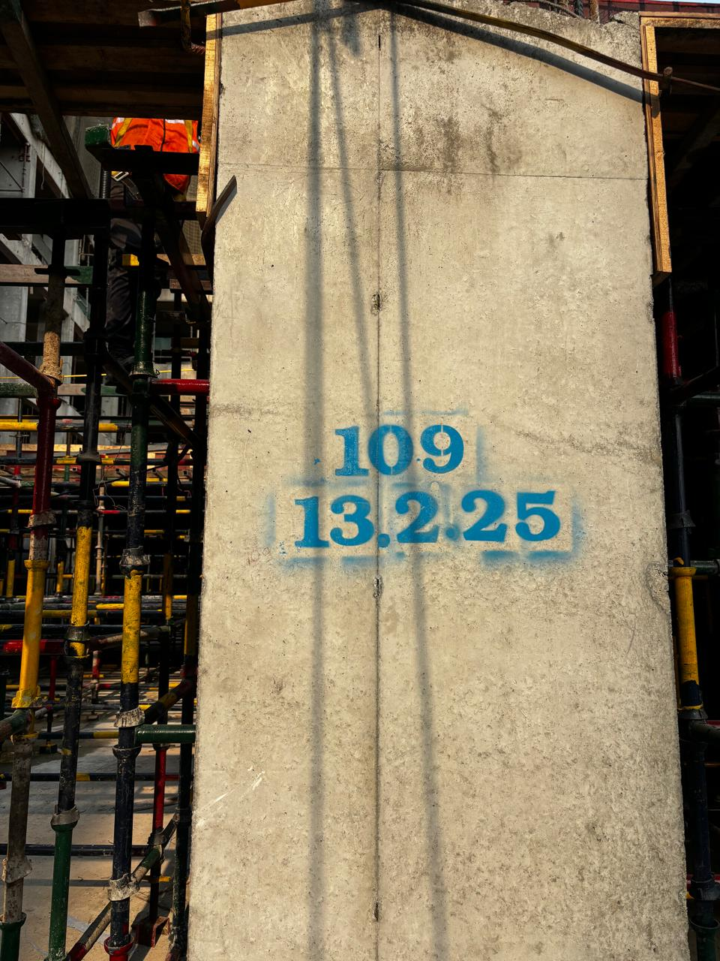
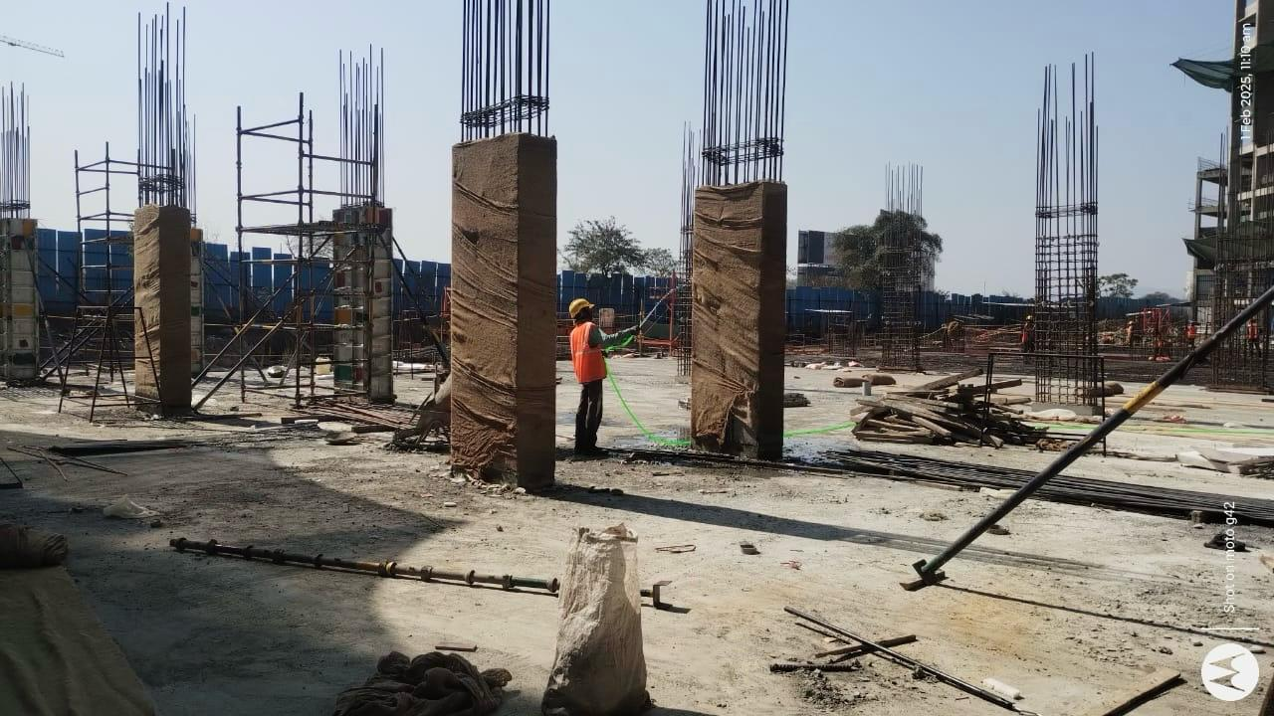
BEST PRACTICES
Description:
Clear identification done in well format to the member for monitoring curing cycle.

Slide 13
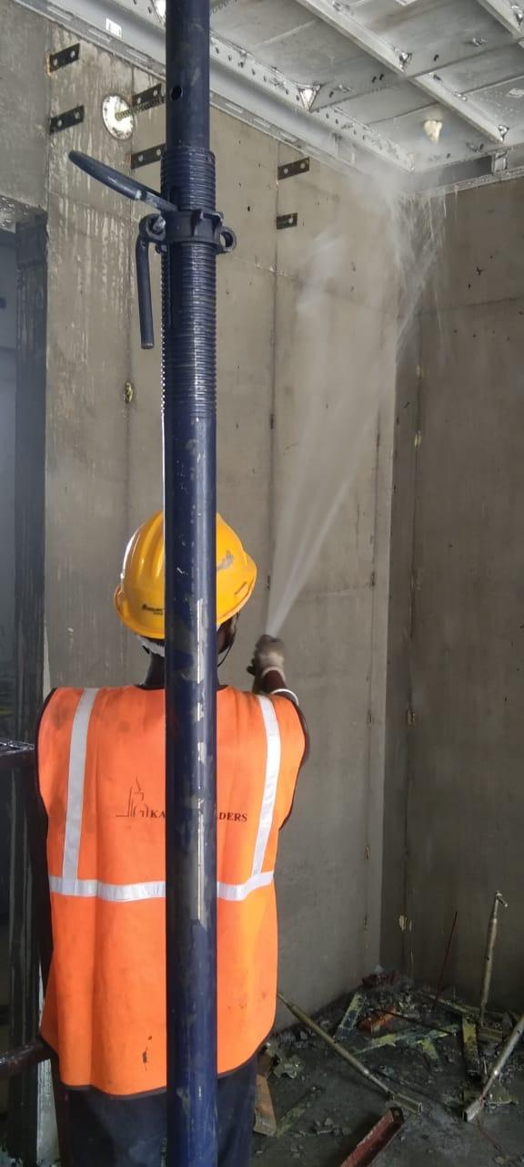
BEST PRACTICES
Description:
After deshuttering mivan wall pannel curing work start up to 7 days

Slide 14
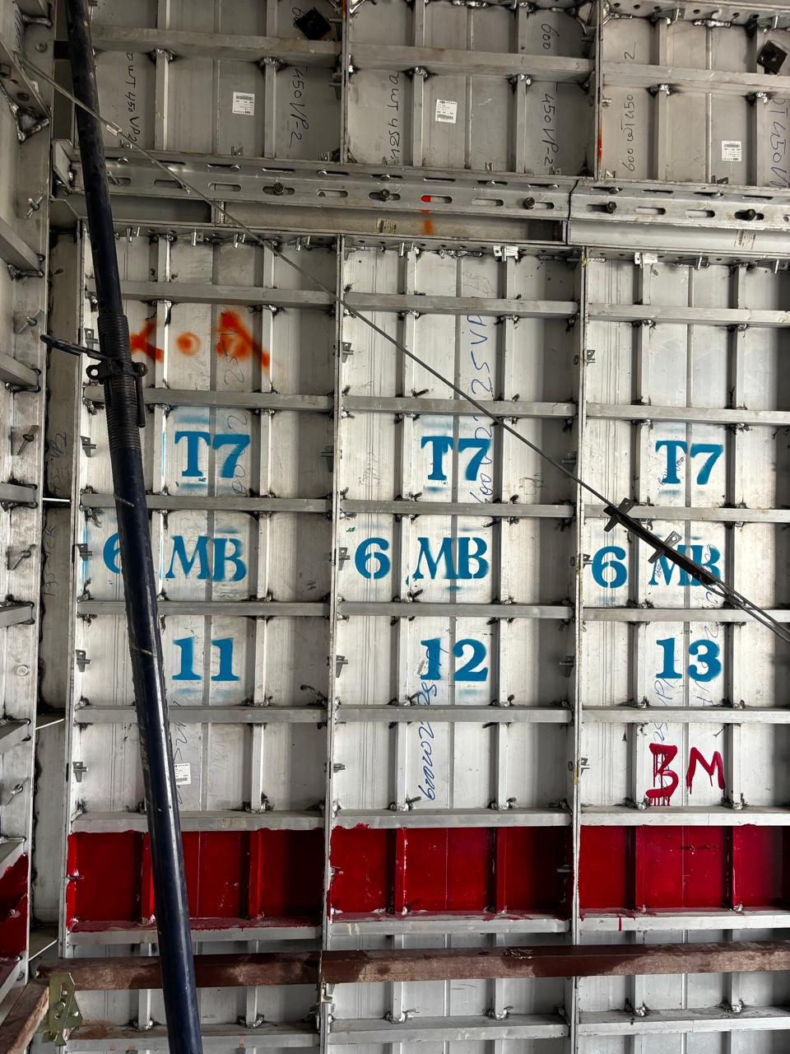
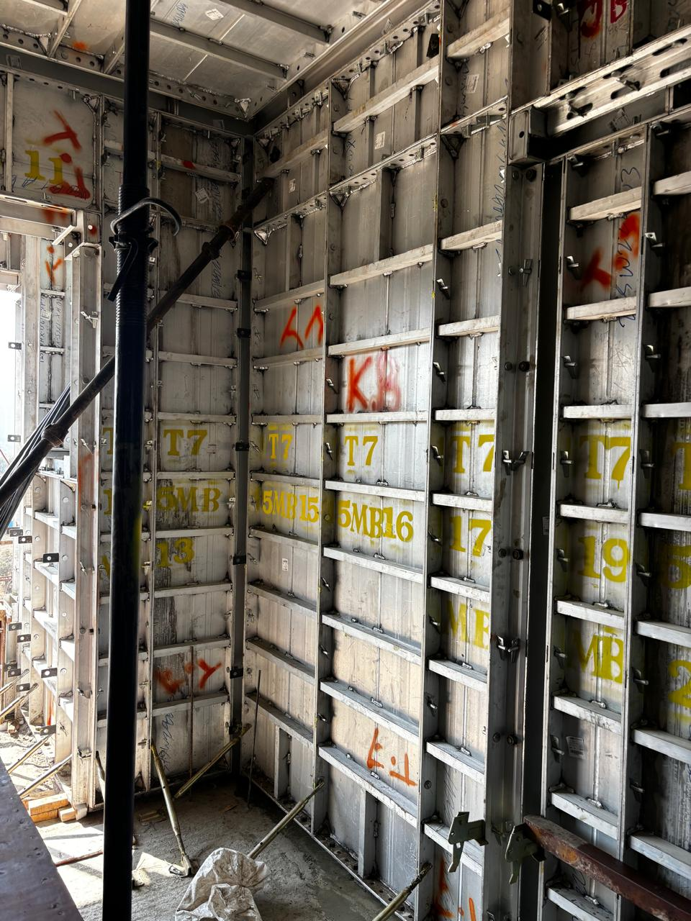
BEST PRACTICES
Description:
Easy to find shuttering component after deshuttering

Slide 15
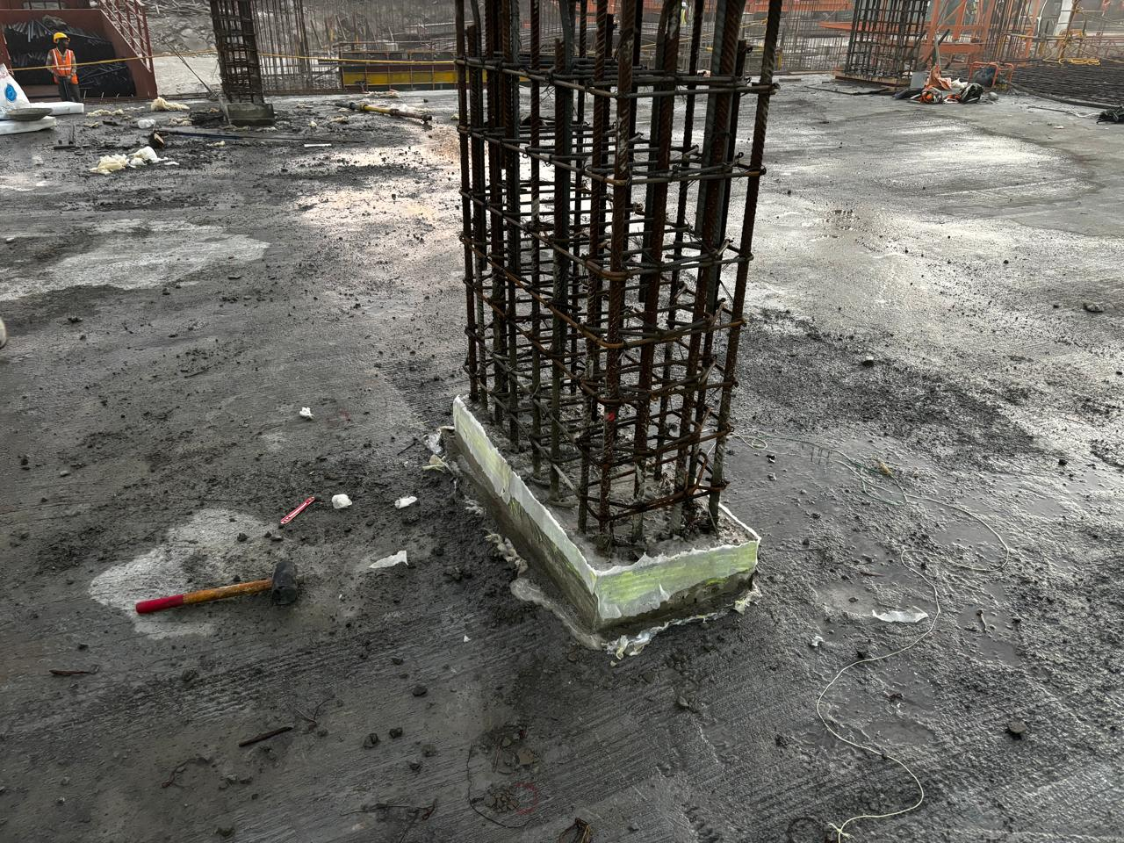
BEST PRACTICES
Description:
Use of foam sheet to column starter for avoiding slurry losses and good joint finishing.(Podium)

Slide 16
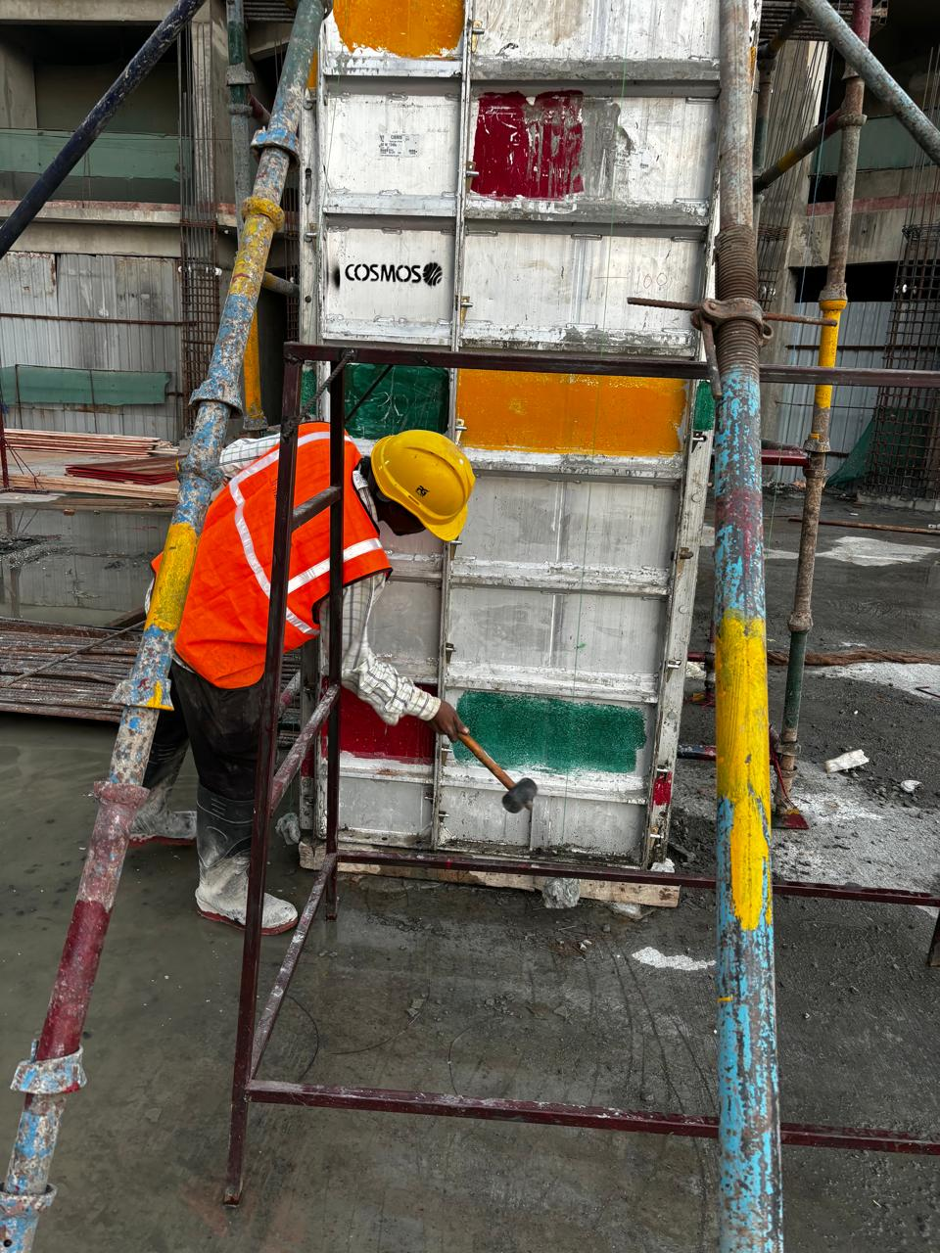
BEST PRACTICES
Description:
Use of Rubber hammering/ Melting During Concreting over Column to avoid voids and also for good finishing .(Podium)

Slide 17
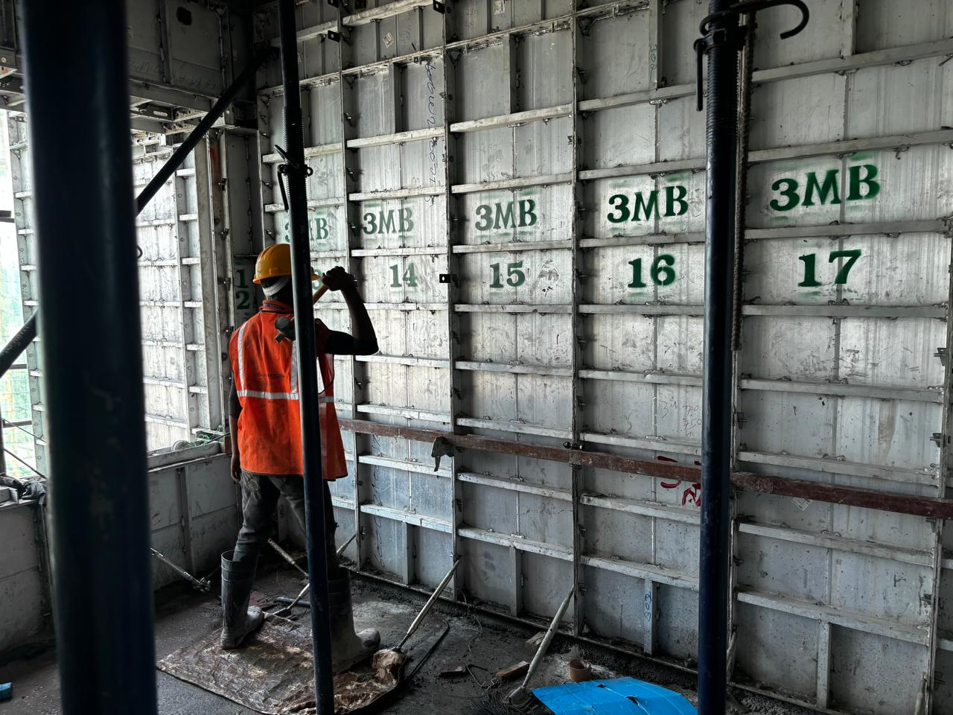
BEST PRACTICES
Description:
Use of Rubber hammering/ Melting During Concreting over shear wall to avoid voids and also for good finishing .(Tower-7)

